Slide 1

DXC TECHNOLOGY
REAL-TIME PROJECT
Unext Learning
Azure Data Analytics
Name – Atharva Jadhav
Roll No. DXC262AB12035
Under Guidance of – Mr. Ajay Kumar

Slide 2

PROJECTS
Project 01 – Connected Vehicles
Project 02 – AP Morgan Data Platform

Slide 3
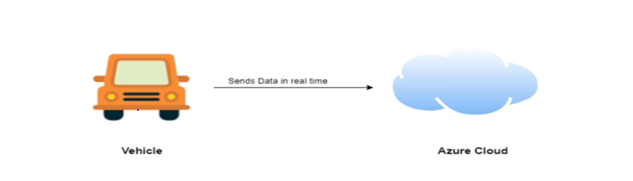
Project 1 – Connected Vehicles
This project is designed to store and validate the IOT data coming from AWS platform which will be validated and move to Azure SQL database

Slide 4

Tasks
Create Azure Data Factory
Create ADF Pipeline
Create Azure blob trigger logic
Create Azure SQL Server and Database
To Move data from Staging to SQL DB

Slide 5

Services Required
To complete this project we need
Following resources –
Azure Data Factory
Azure Storage Account
Azure SQL Database

Slide 6

Task 1—Create Azure Data Factory
Azure Data Factory is Cloud based ETL platform for data integration and transformation of scaled data

Slide 7
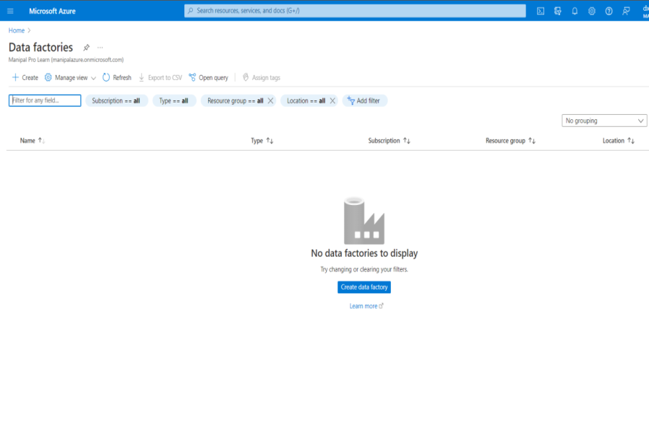
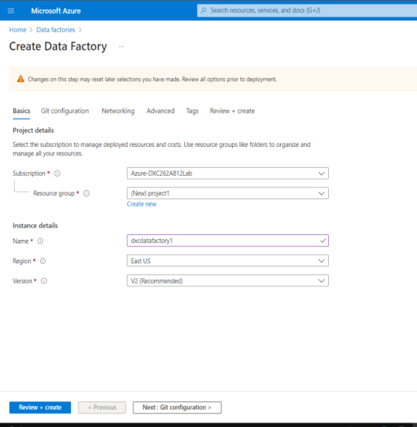
Creating Azure Data Factory
Go to Azure and search Azure Data Factory
Enter Required Information and click on create and deploy

Slide 8
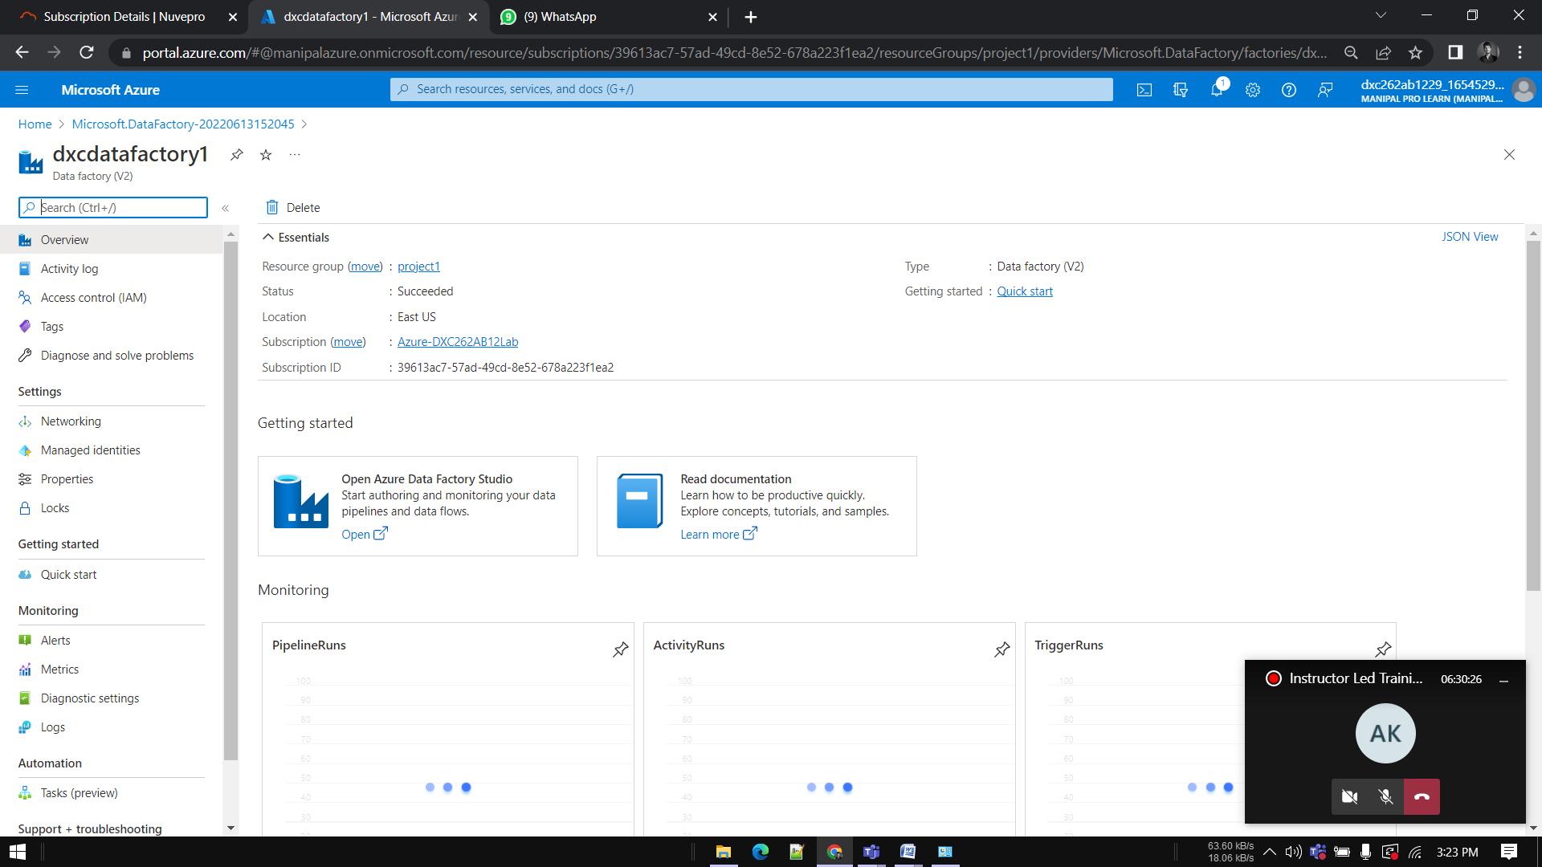
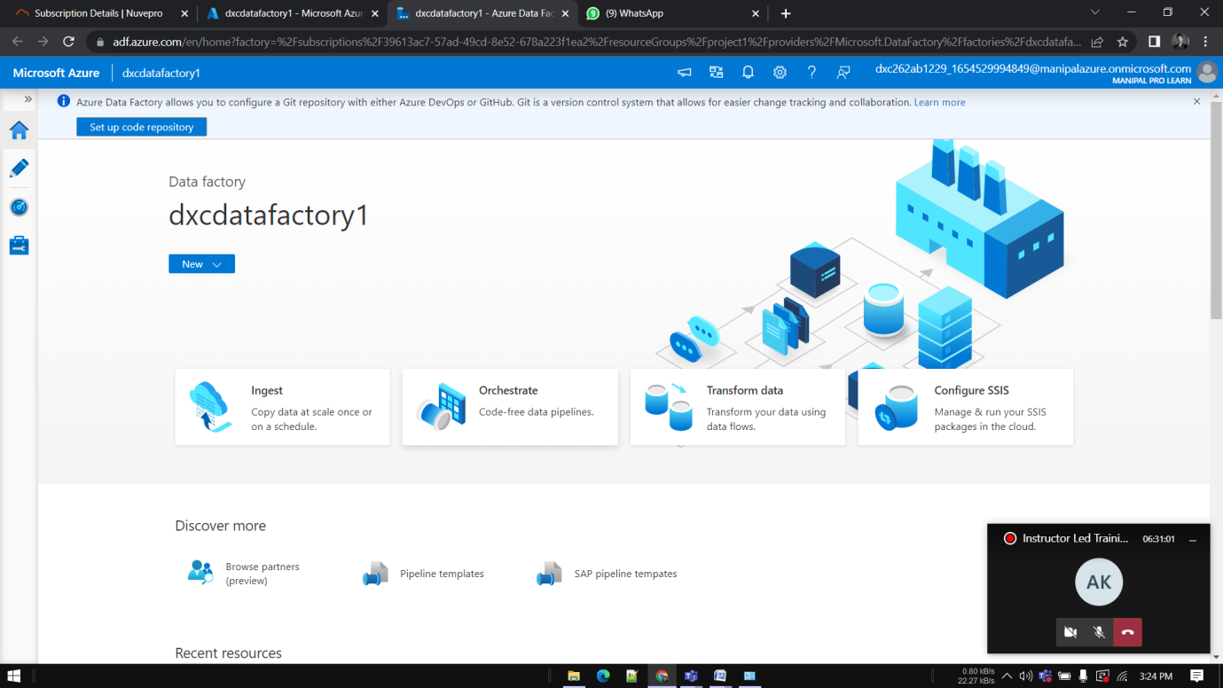
Azure Data Factory
Successfully deployed ADF

Slide 9
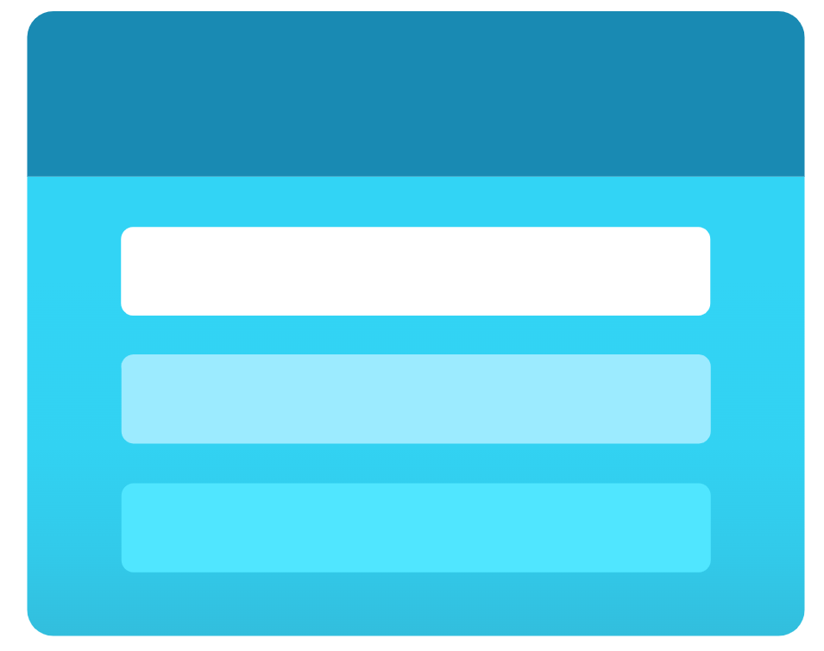
Task 2— Create a Storage account
An Azure storage account contains Azure Storage data objects, including blobs, file shares, queues, tables, and disks.

Slide 10
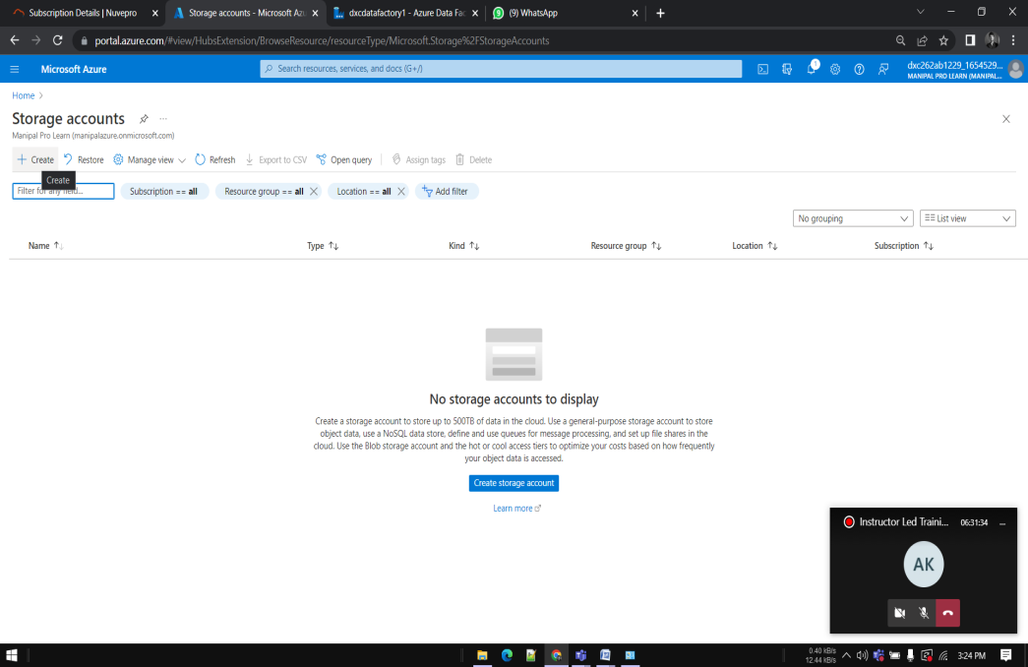
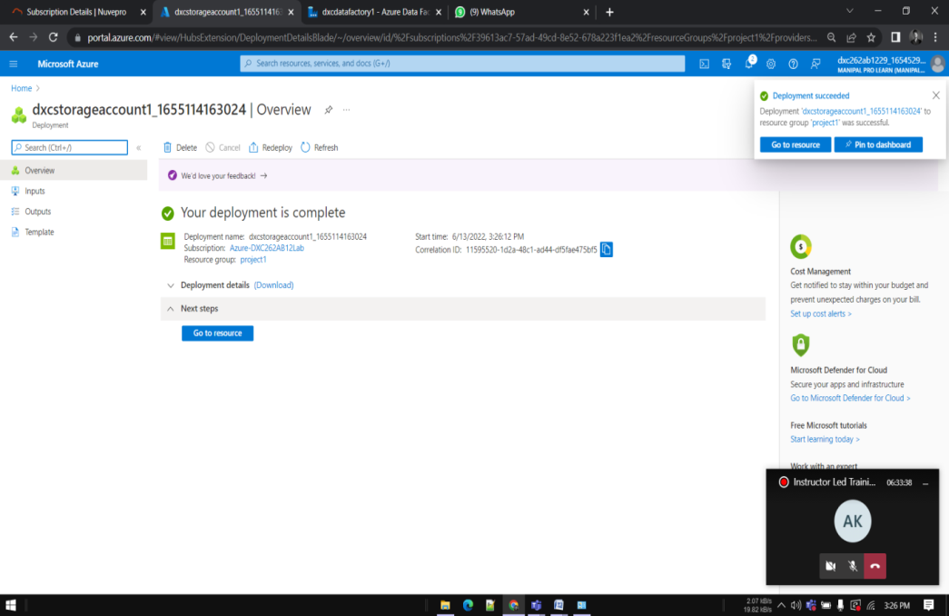
Creating Storage account
Go to Azure , search for storage. Click on Create.
Enter info and Deploy the storage Account

Slide 11
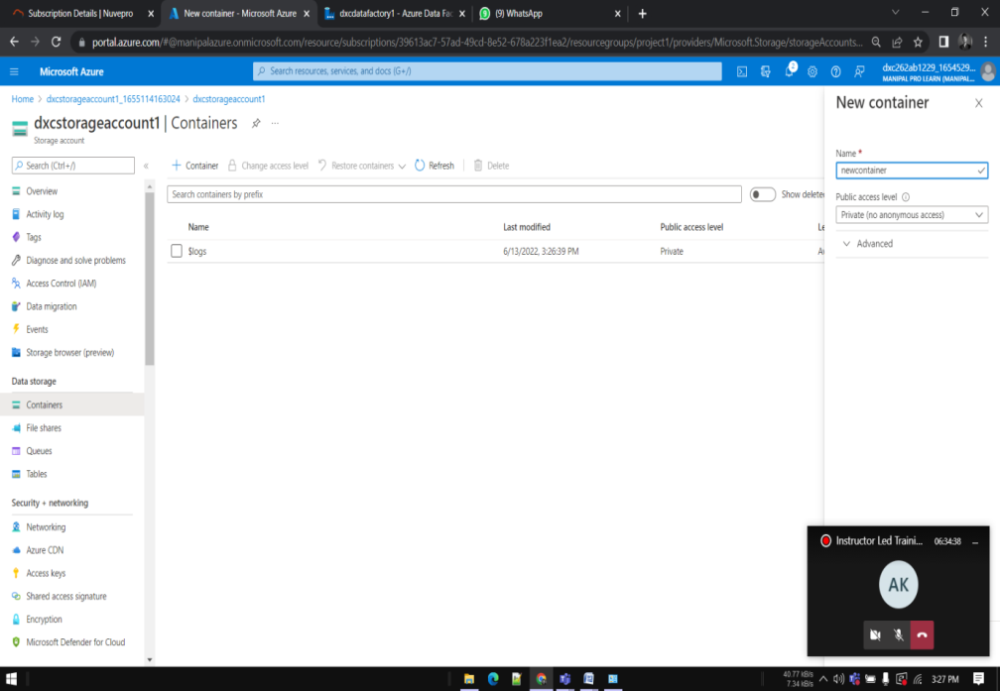

Container
Go towards containers. Click on Create.
Give a name to the container Click on upload.
Add sample file to upload in blob.

Slide 12
SQL DATABASE
Now we need to create Azure SQL server and SQL Database.

Slide 13
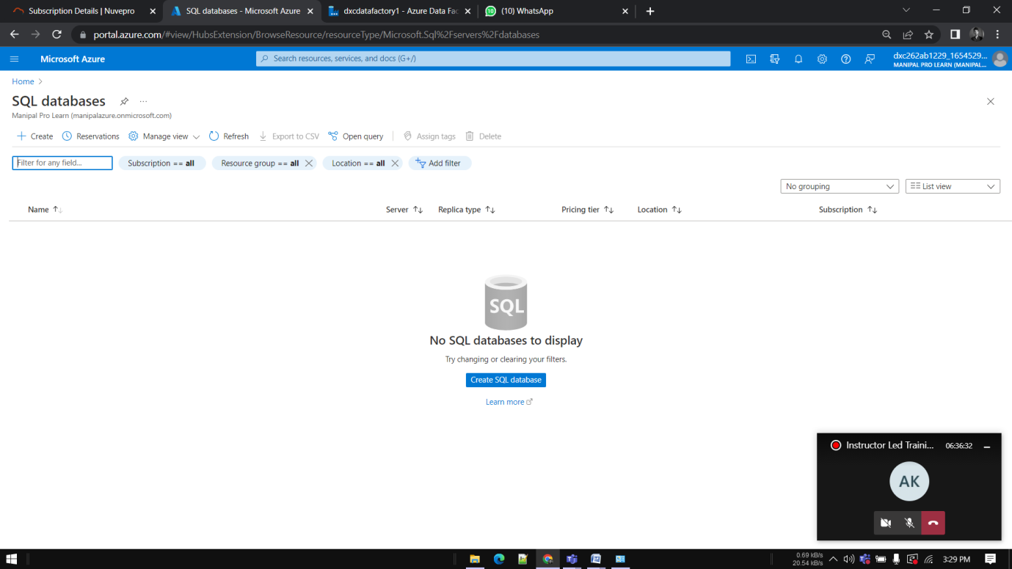
SQL DATABASE
Click on +Create icon to create SQL Database

Slide 14
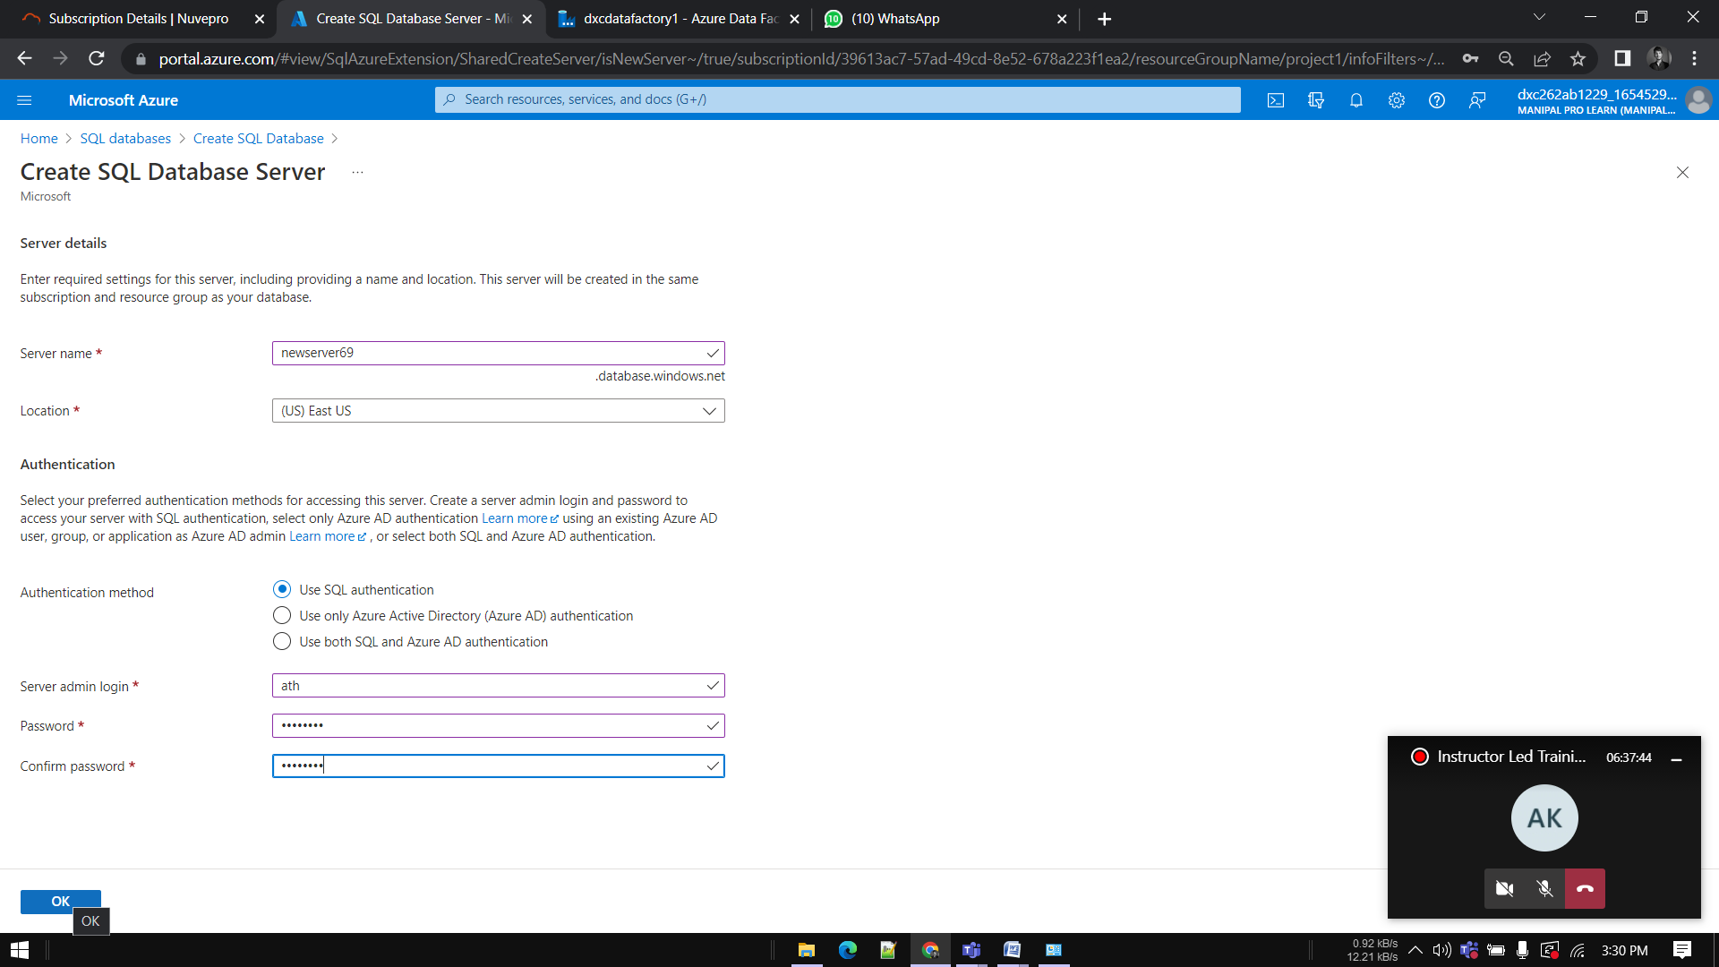
SQL DATABASE SERVER
Choose existing server if you have any or click on create new

Slide 15
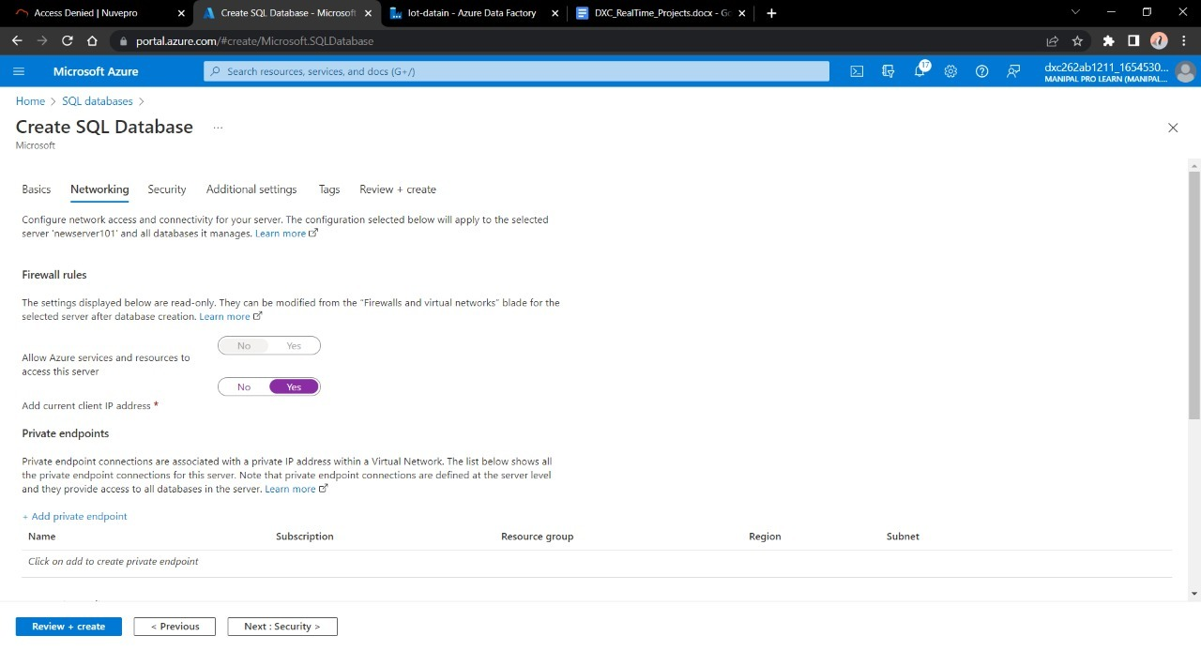
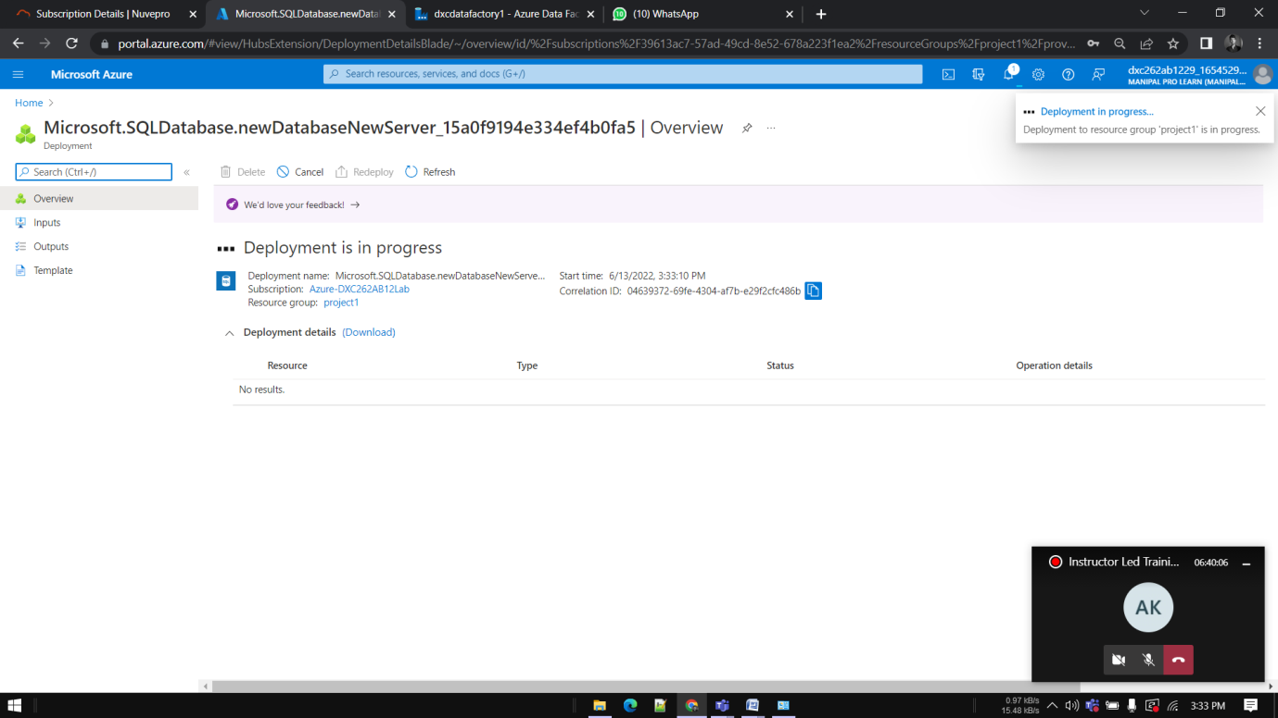
SQL DATABASE
Enable the firewall for the current IP and for the same azure cloud, review and deploy the database

Slide 16
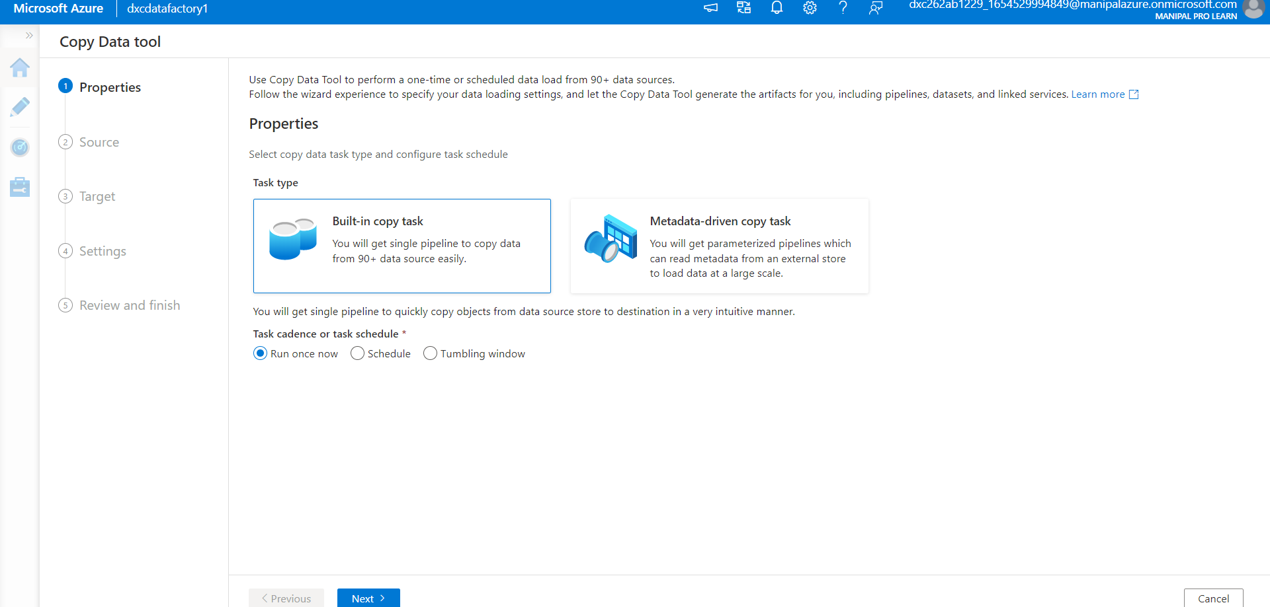
INJESTING DATA
Go to Data factory that we created, Click on ingest

Slide 17
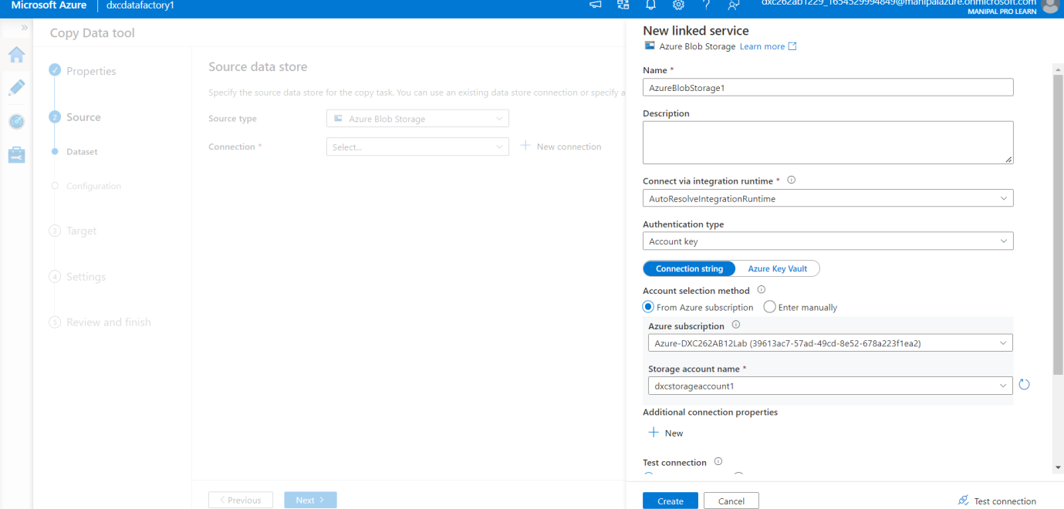
Pipeline
Enter the name of Azure blob storage linked file. Select the name of storage account we created and click on Create. Click on next.

Slide 18
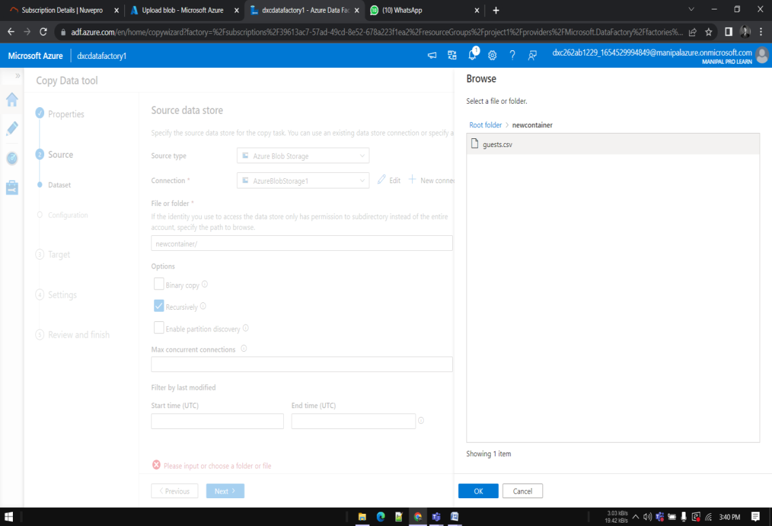
Source
Choose the sample file we have uploaded in blob.

Slide 19
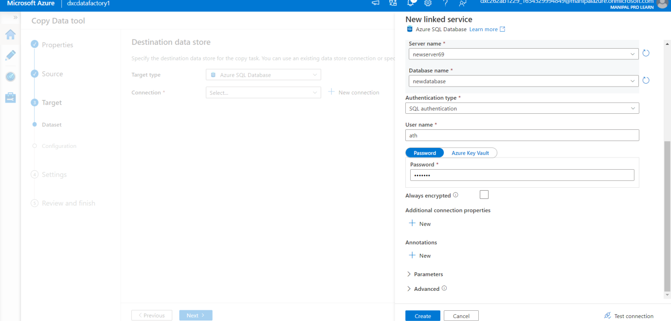
Destination
Connect the database with new connection.

Slide 20
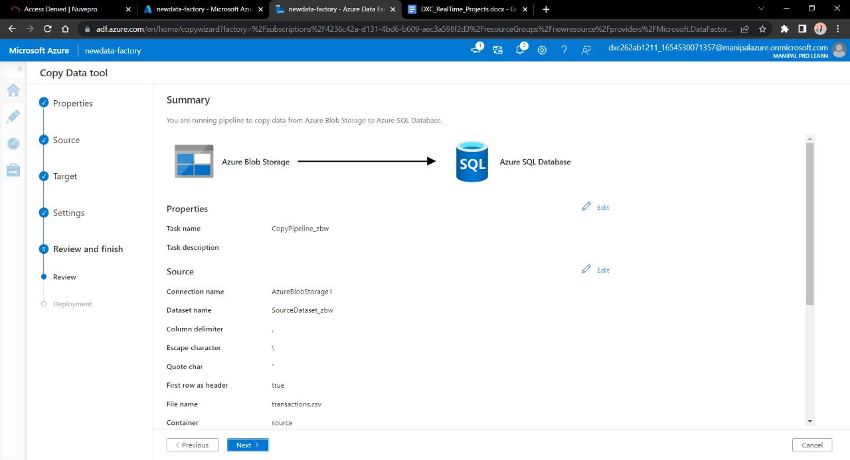
Validate and Deploy
Validate the data , connection , details and click on next button

Slide 21
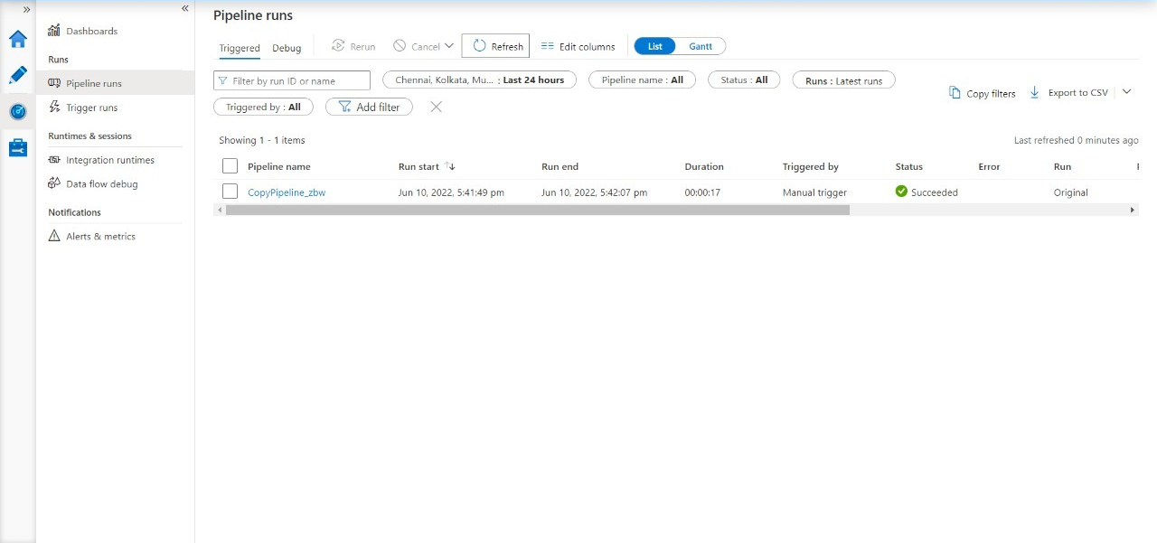
Triggering Pipeline
After Pipeline is ready review and trigger it.

Slide 22
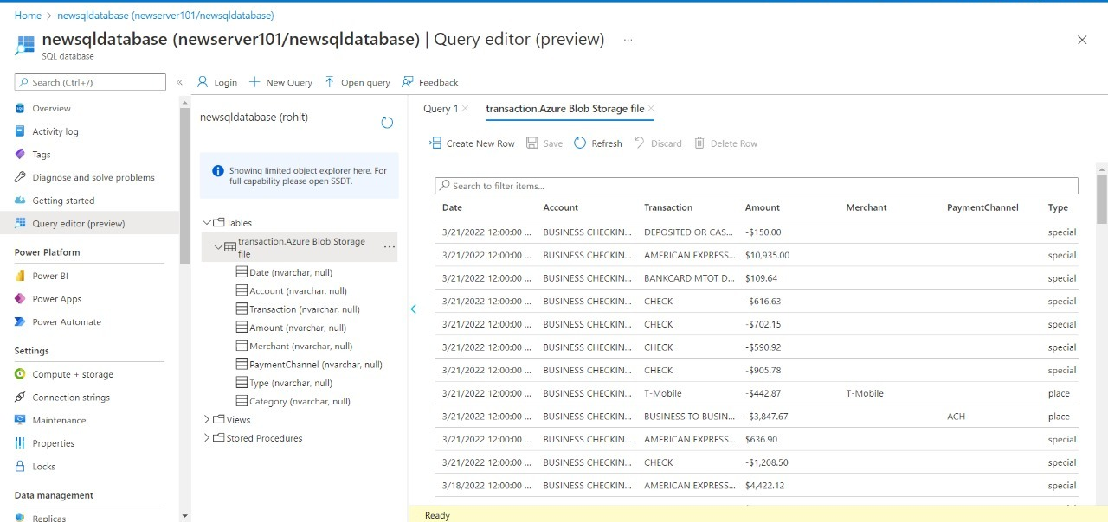
Result
Go to SQL database in order to check the data.

Slide 23

Conclusion
Successfully created pipeline which validates and copies the blob data into SQL DB using Azure data factory

Slide 24
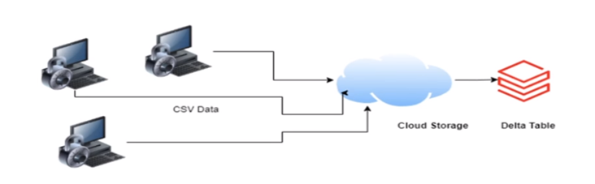
Project 2 – AP MORGAN DATA PLATFORM
Data is coming from various sources, we need to collect this data and integrate it into databricks for further analysis

Slide 25
Tasks
Create a Databrick
Create Cluster in Azure Databricks
Add notebook in Databricks and Implement the Business Logic
Create Azure Data Factory
Create Azure Databricks Linked Service in ADF

Slide 26
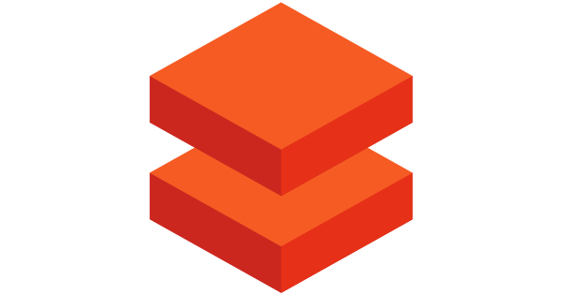
Data Bricks
Azure Databricks is an easy, fast, and collaborative Apache spark-based data analytics platform for the Microsoft Azure cloud services platform

Slide 27
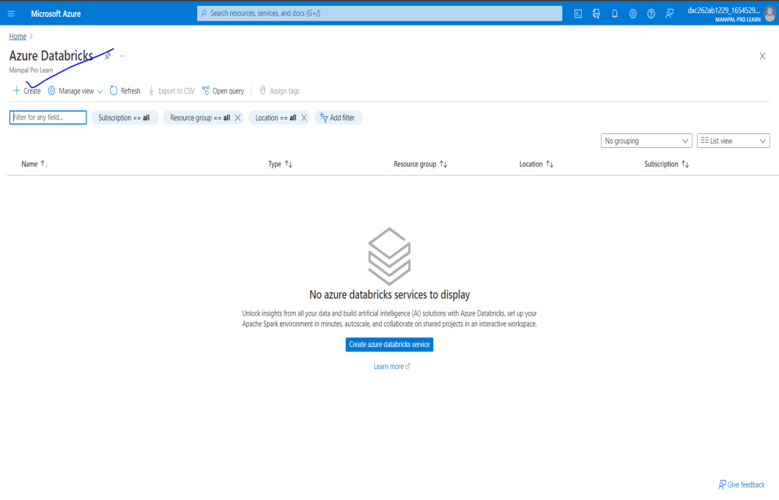
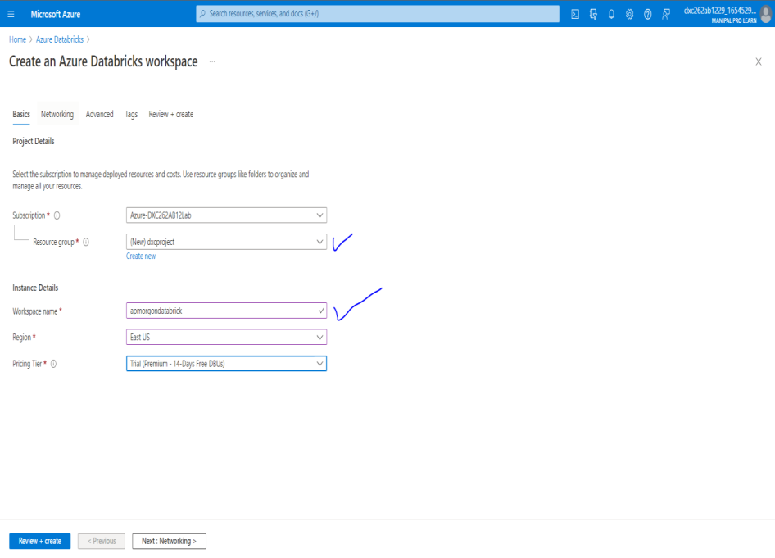
Data Bricks
Navigate and open data bricks, click on create.
Fill required information and click on deploy.
Launch the workspace.

Slide 28
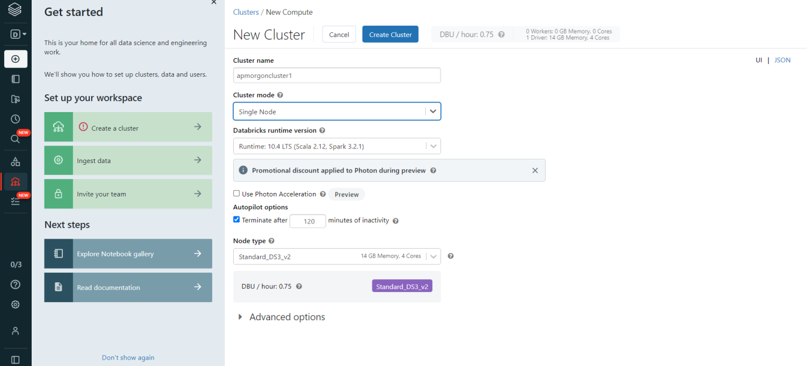
Create a new cluster
Click on create icon, select create a cluster option
Give the necessary details for the cluster and click on create

Slide 29
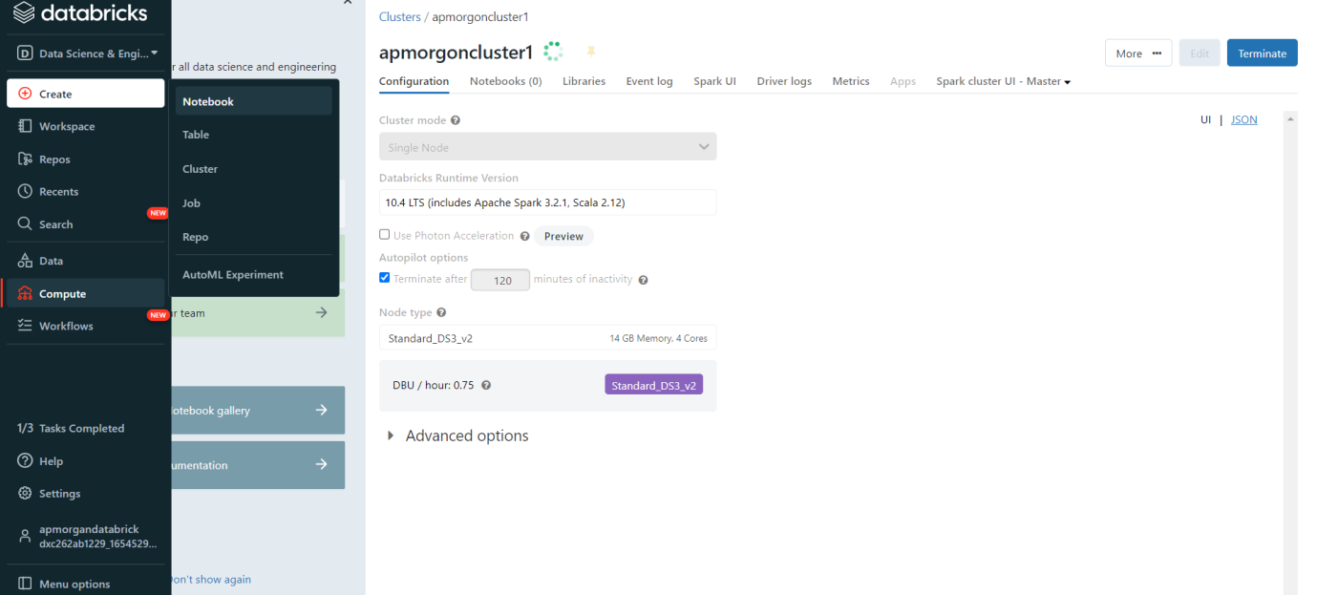
Create notebook
Click on create and select notebook
Fill required details and Click on create

Slide 30
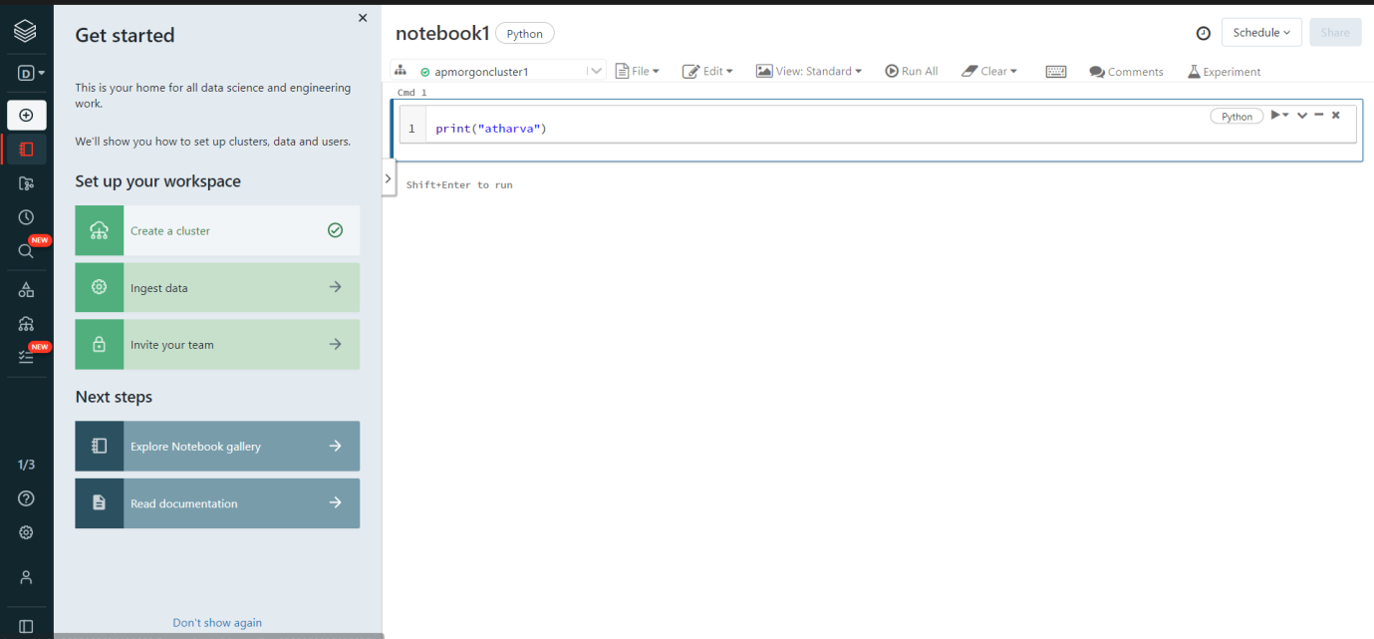
Create notebook
After creation give some operation or Do the logic building in the notebook

Slide 31
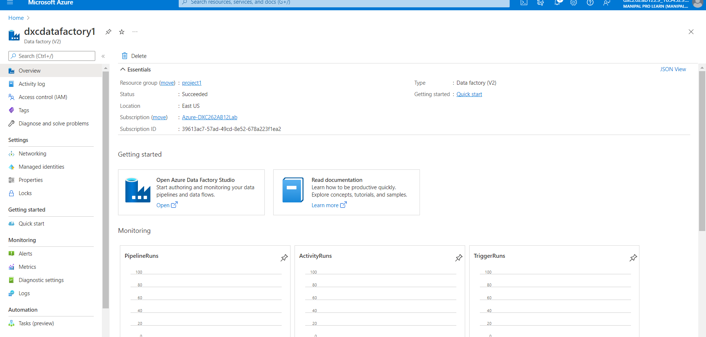
Go to azure page and create Data Factory
Create a data factory like we did in previous project
Now open the Data Factory studio
Click on create a pipeline

Slide 32
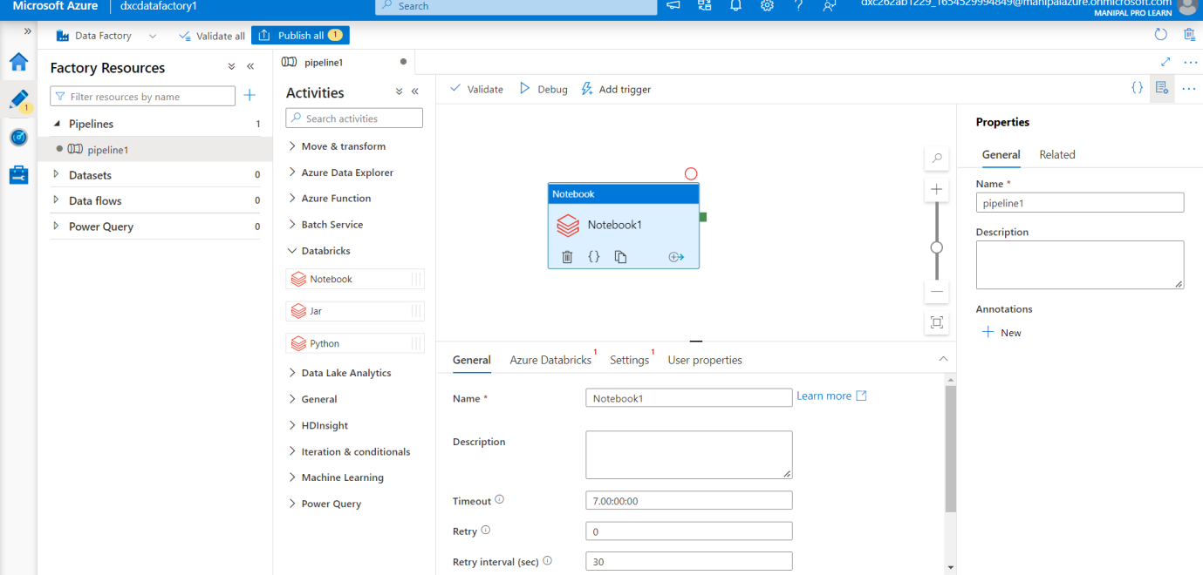
Create a new Pipeline
Create a new Pipeline and drop the notebook from Azure Databricks dropdown into the pipeline workspace.
Create a new Linked service

Slide 33
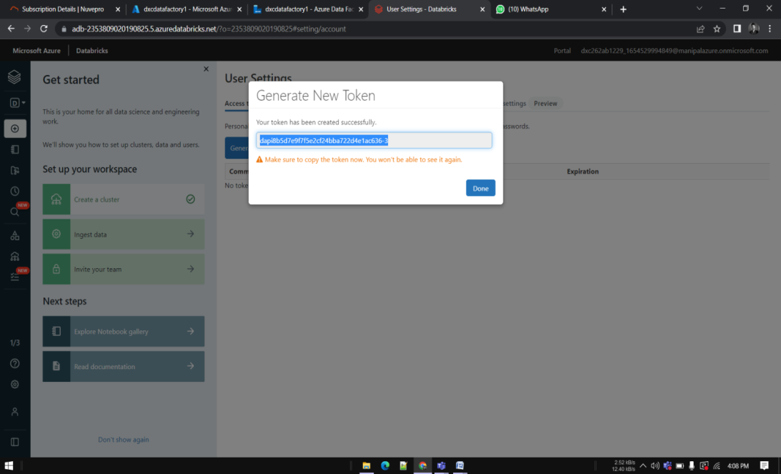
Generate a token
Go to Data bricks and go to Users settings
Click on Generate token and copy the token

Slide 34
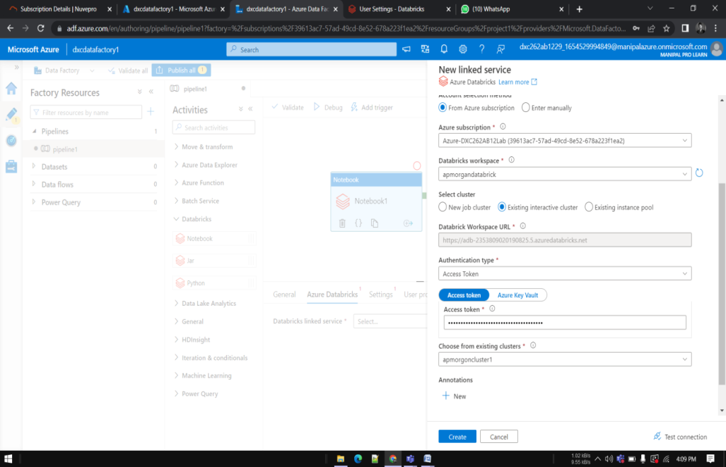
New Linked Service
Paste it in the azure factory data connection form.
Choose the right cluster and click on create

Slide 35
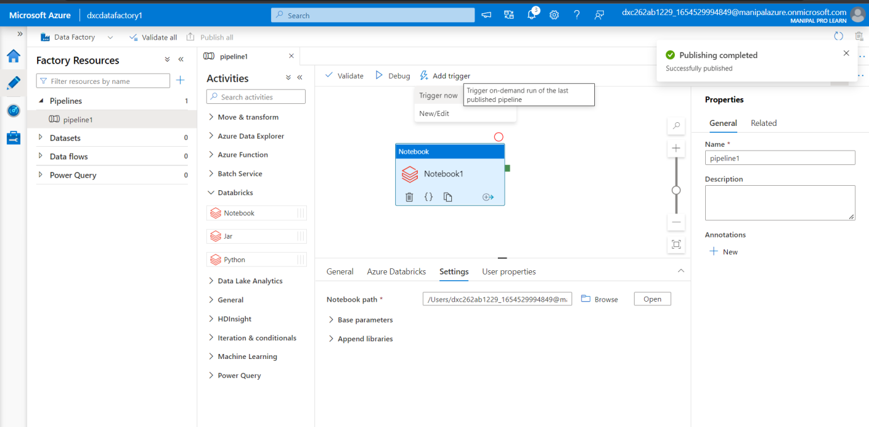
Publishing the pipeline
Publish the pipeline, After publication click on Trigger now

Slide 36
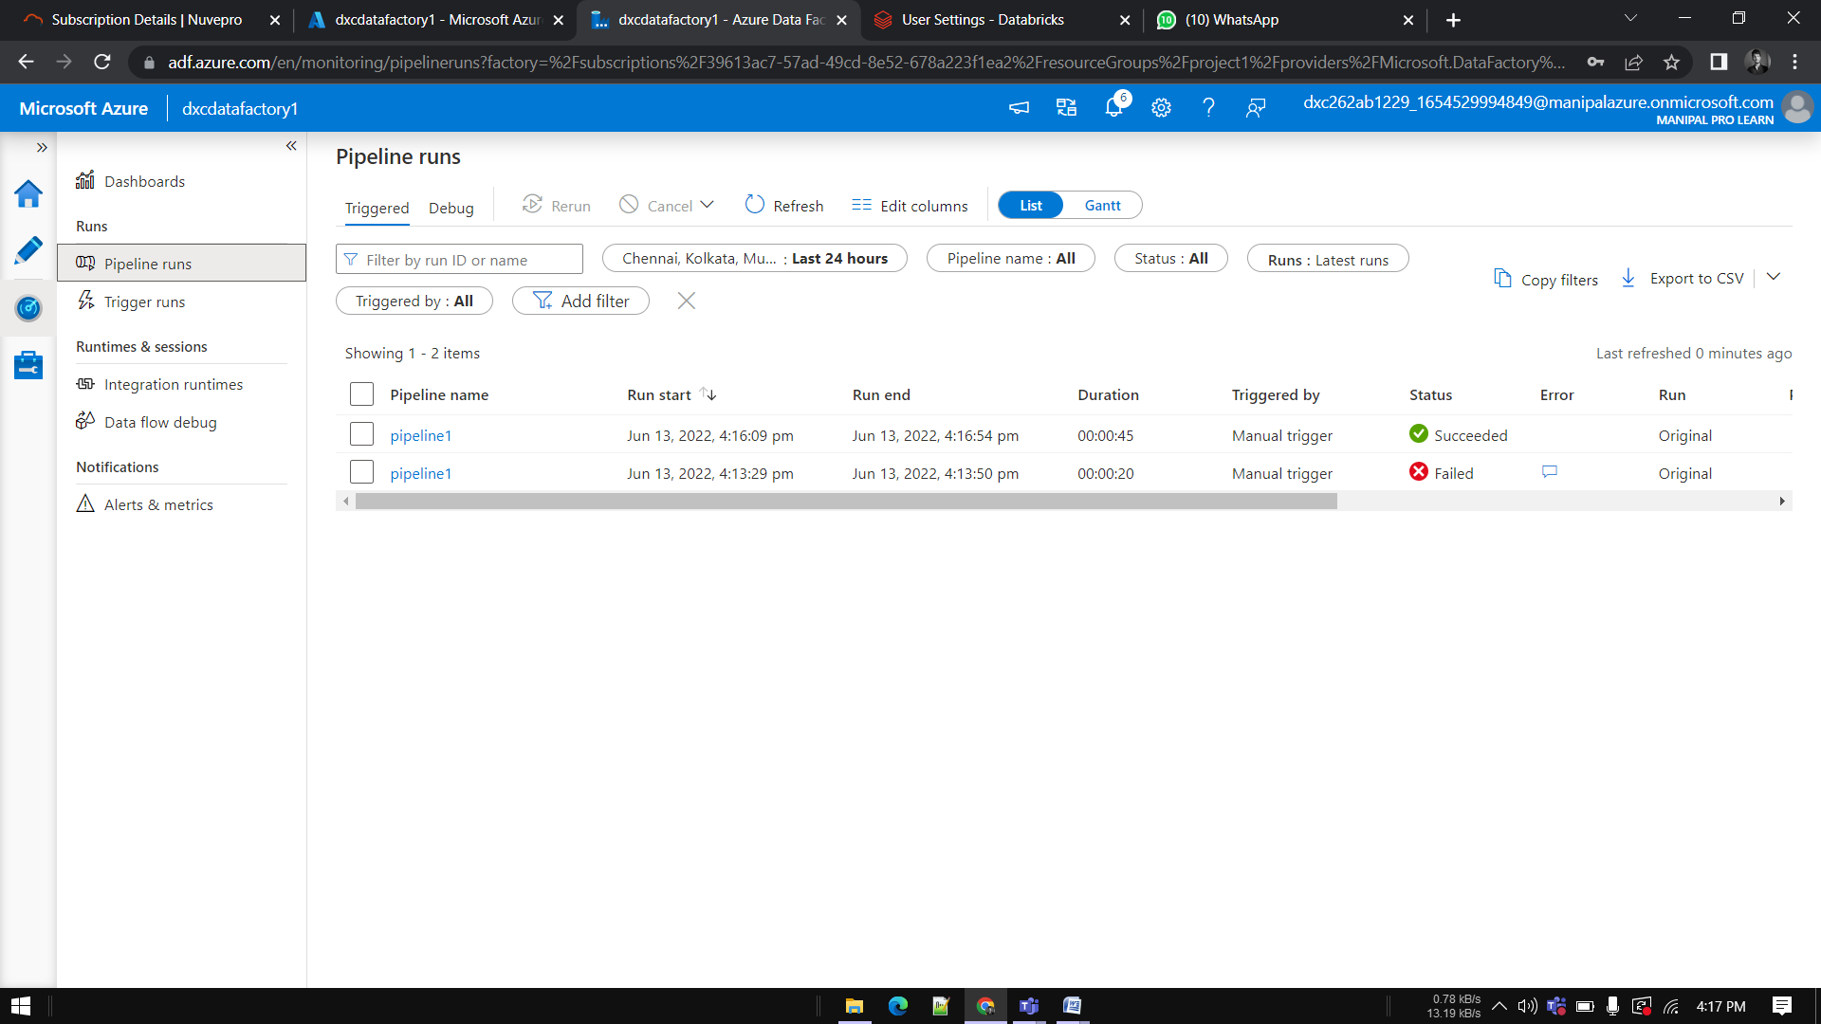
Result
Go to Monitor window in order to check it’s execution

Slide 37

Conclusion
Successfully created Azure Data bricks and notebook using Azure Data Factory published and triggered the pipeline

Slide 38

THANK YOU !

